Slide 1
Population Structure
BIO 594-
University of Rhode Island

Slide 2

Outline
How do we detect population structure and what does that mean?
Live Coding
Take Home Exercise
BIO 594

Slide 3
Traditional population genetics
Population genetics is based on sampling discrete interbreeding subpopulations.
Wright/Fisher Island Model
all sub populations are in HWE
1 = p² + 2pq + q²
Migration is equal across subpopulations
BIO 594

Slide 4
Traditional population genetics
Questions?
Population connectivity
Long term
Demographic
Effective population size
Bottlenecks?
What is a population?
Admixture?
When did populations diverge?
BIO 594

Slide 5
Traditional population genetics
Population genetics is based on sampling discrete interbreeding subpopulations.
Stepping stone model
All subpopulations are in HWE
Migration is equal only between
neighboring populations
Island/Continent model
Metapopulation model
BIO 594

Slide 6
Understanding F_{ST}
BIO 594

Slide 7
Understanding F_{ST}
No Connectivity
F_{ST} = 1.0
BIO 594

Slide 8
Understanding F_{ST}
Low Connectivity
F_{ST} = 0.36
BIO 594

Slide 9
Understanding F_{ST}
High Connectivity
F_{ST} = 0.0
BIO 594

Slide 10
Spatial patterns in population genetics
Isolation by distance
Genetic distance increases with geographic distance
For a long time, this was one of the only spatially explicit models in population genetics
Usually performed on transformed genetic and Euclidean/Cartesian distances
Using a mantel test
Testing the correlation between two matrices
BIO 594

Slide 11
Fine-scale genetic structure of Red Snapper in the northern Gulf of Mexico
Jonathan B. Puritz, David S. Portnoy, and John R. Gold

Slide 12
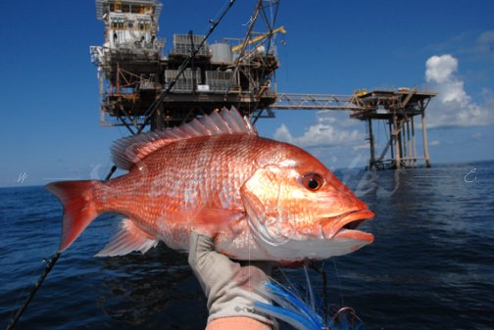
Red Snapper as a fishery
Red Snapper is one of the largest and most valuable US Fisheries
~10 million lbs per year
>$720 million per year

Slide 13
Population structure and management
Different subpopulations may possess adaptations that promote differences in critical life history parameters
growth
fecundity
disease resistance
Different subpopulations may also have different effective population sizes and migration rates
correlates to vulnerability from exploitation

Slide 14
Red Snapper population structure?
Neutral genetic markers have been largely unable to detect local or regional spatial structure
Though structure was detected between GOM and Atlantic (Hollenbeck et al. 2015)
Among young of the year (YOY), genotypes are spatially autocorrelated within 50-100 km (Saillant et al. 2010)

Slide 15
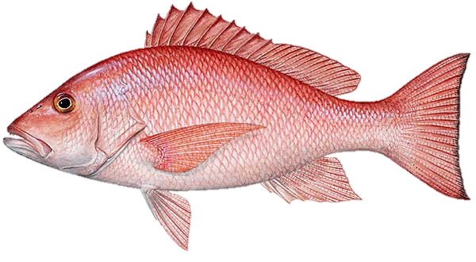
RAD data
Quality Filtering
De Novo Assembly
Read Mapping
SNP Calling
SNP Filtering
SNPs were filtered by genotype depth, allelic balance, HWE, average locus depth, and a variety of other bioinformatics
4,337 SNPs haplotyped into 2,073 RAD loci
205 individuals from 8 localities

Slide 16
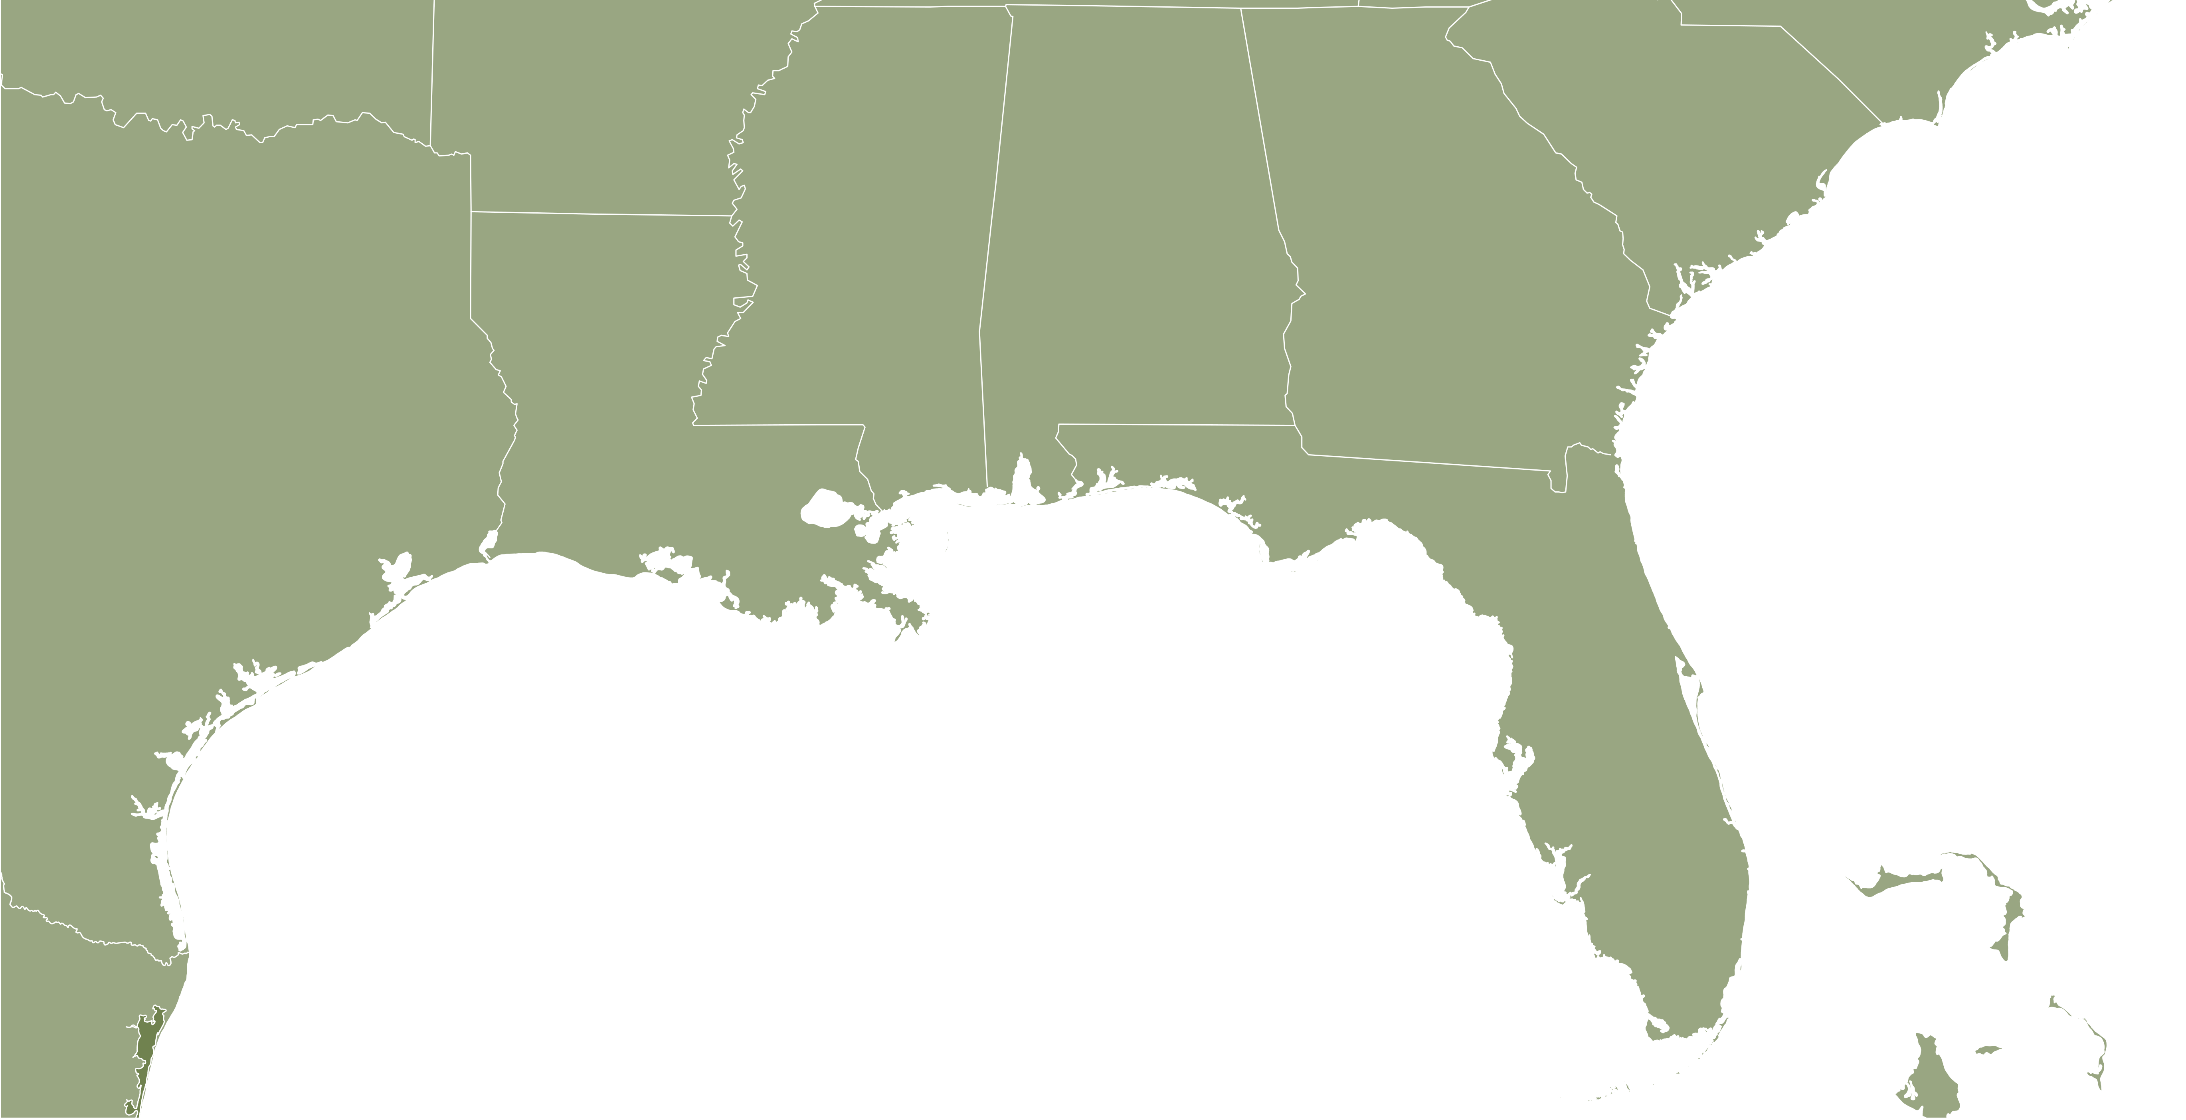
Changing the scale

Slide 17
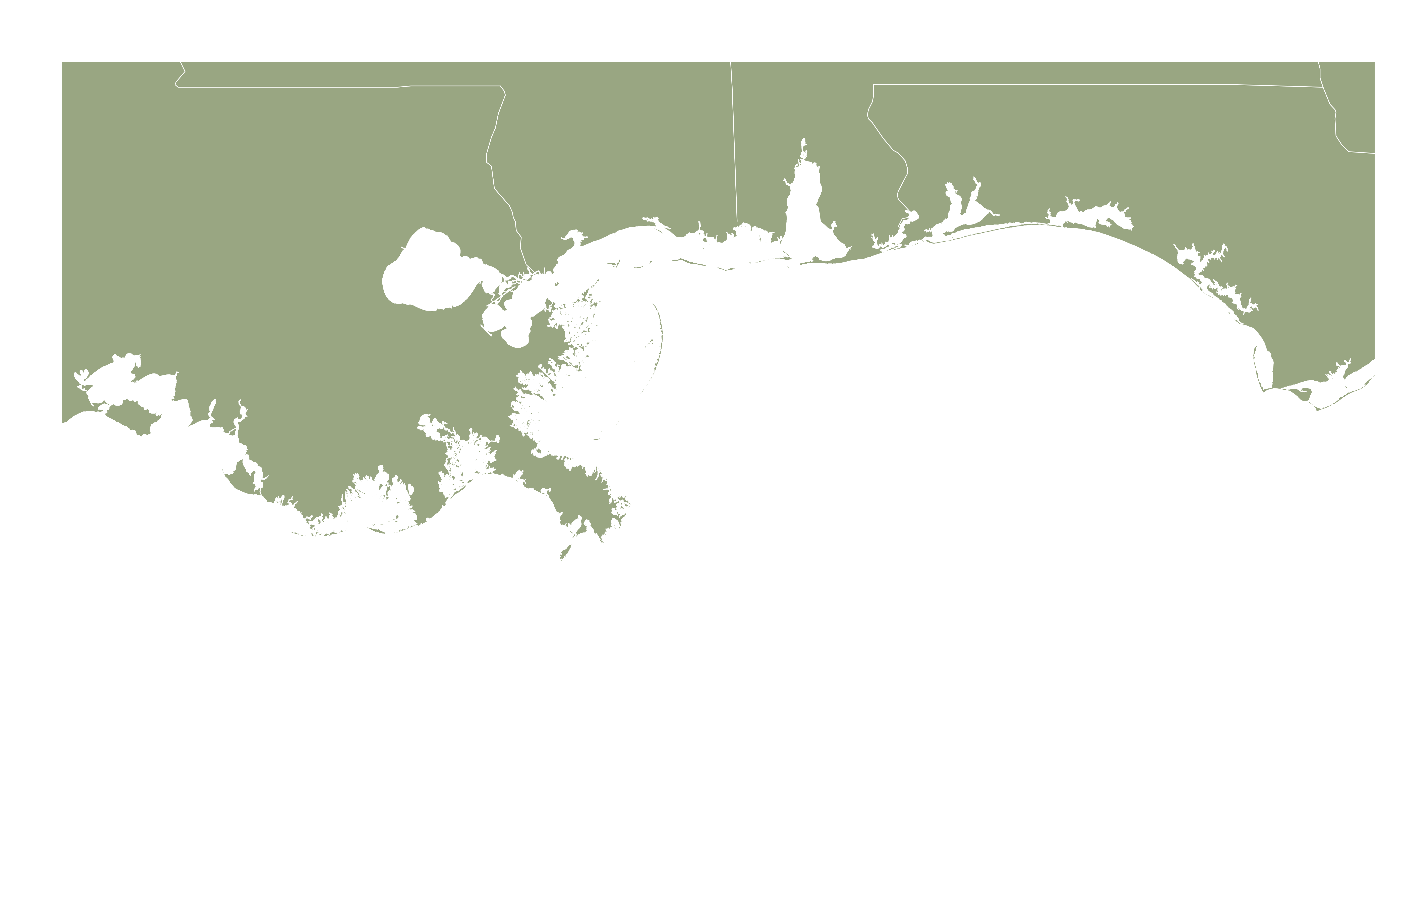
Fine-scale sampling

Slide 18
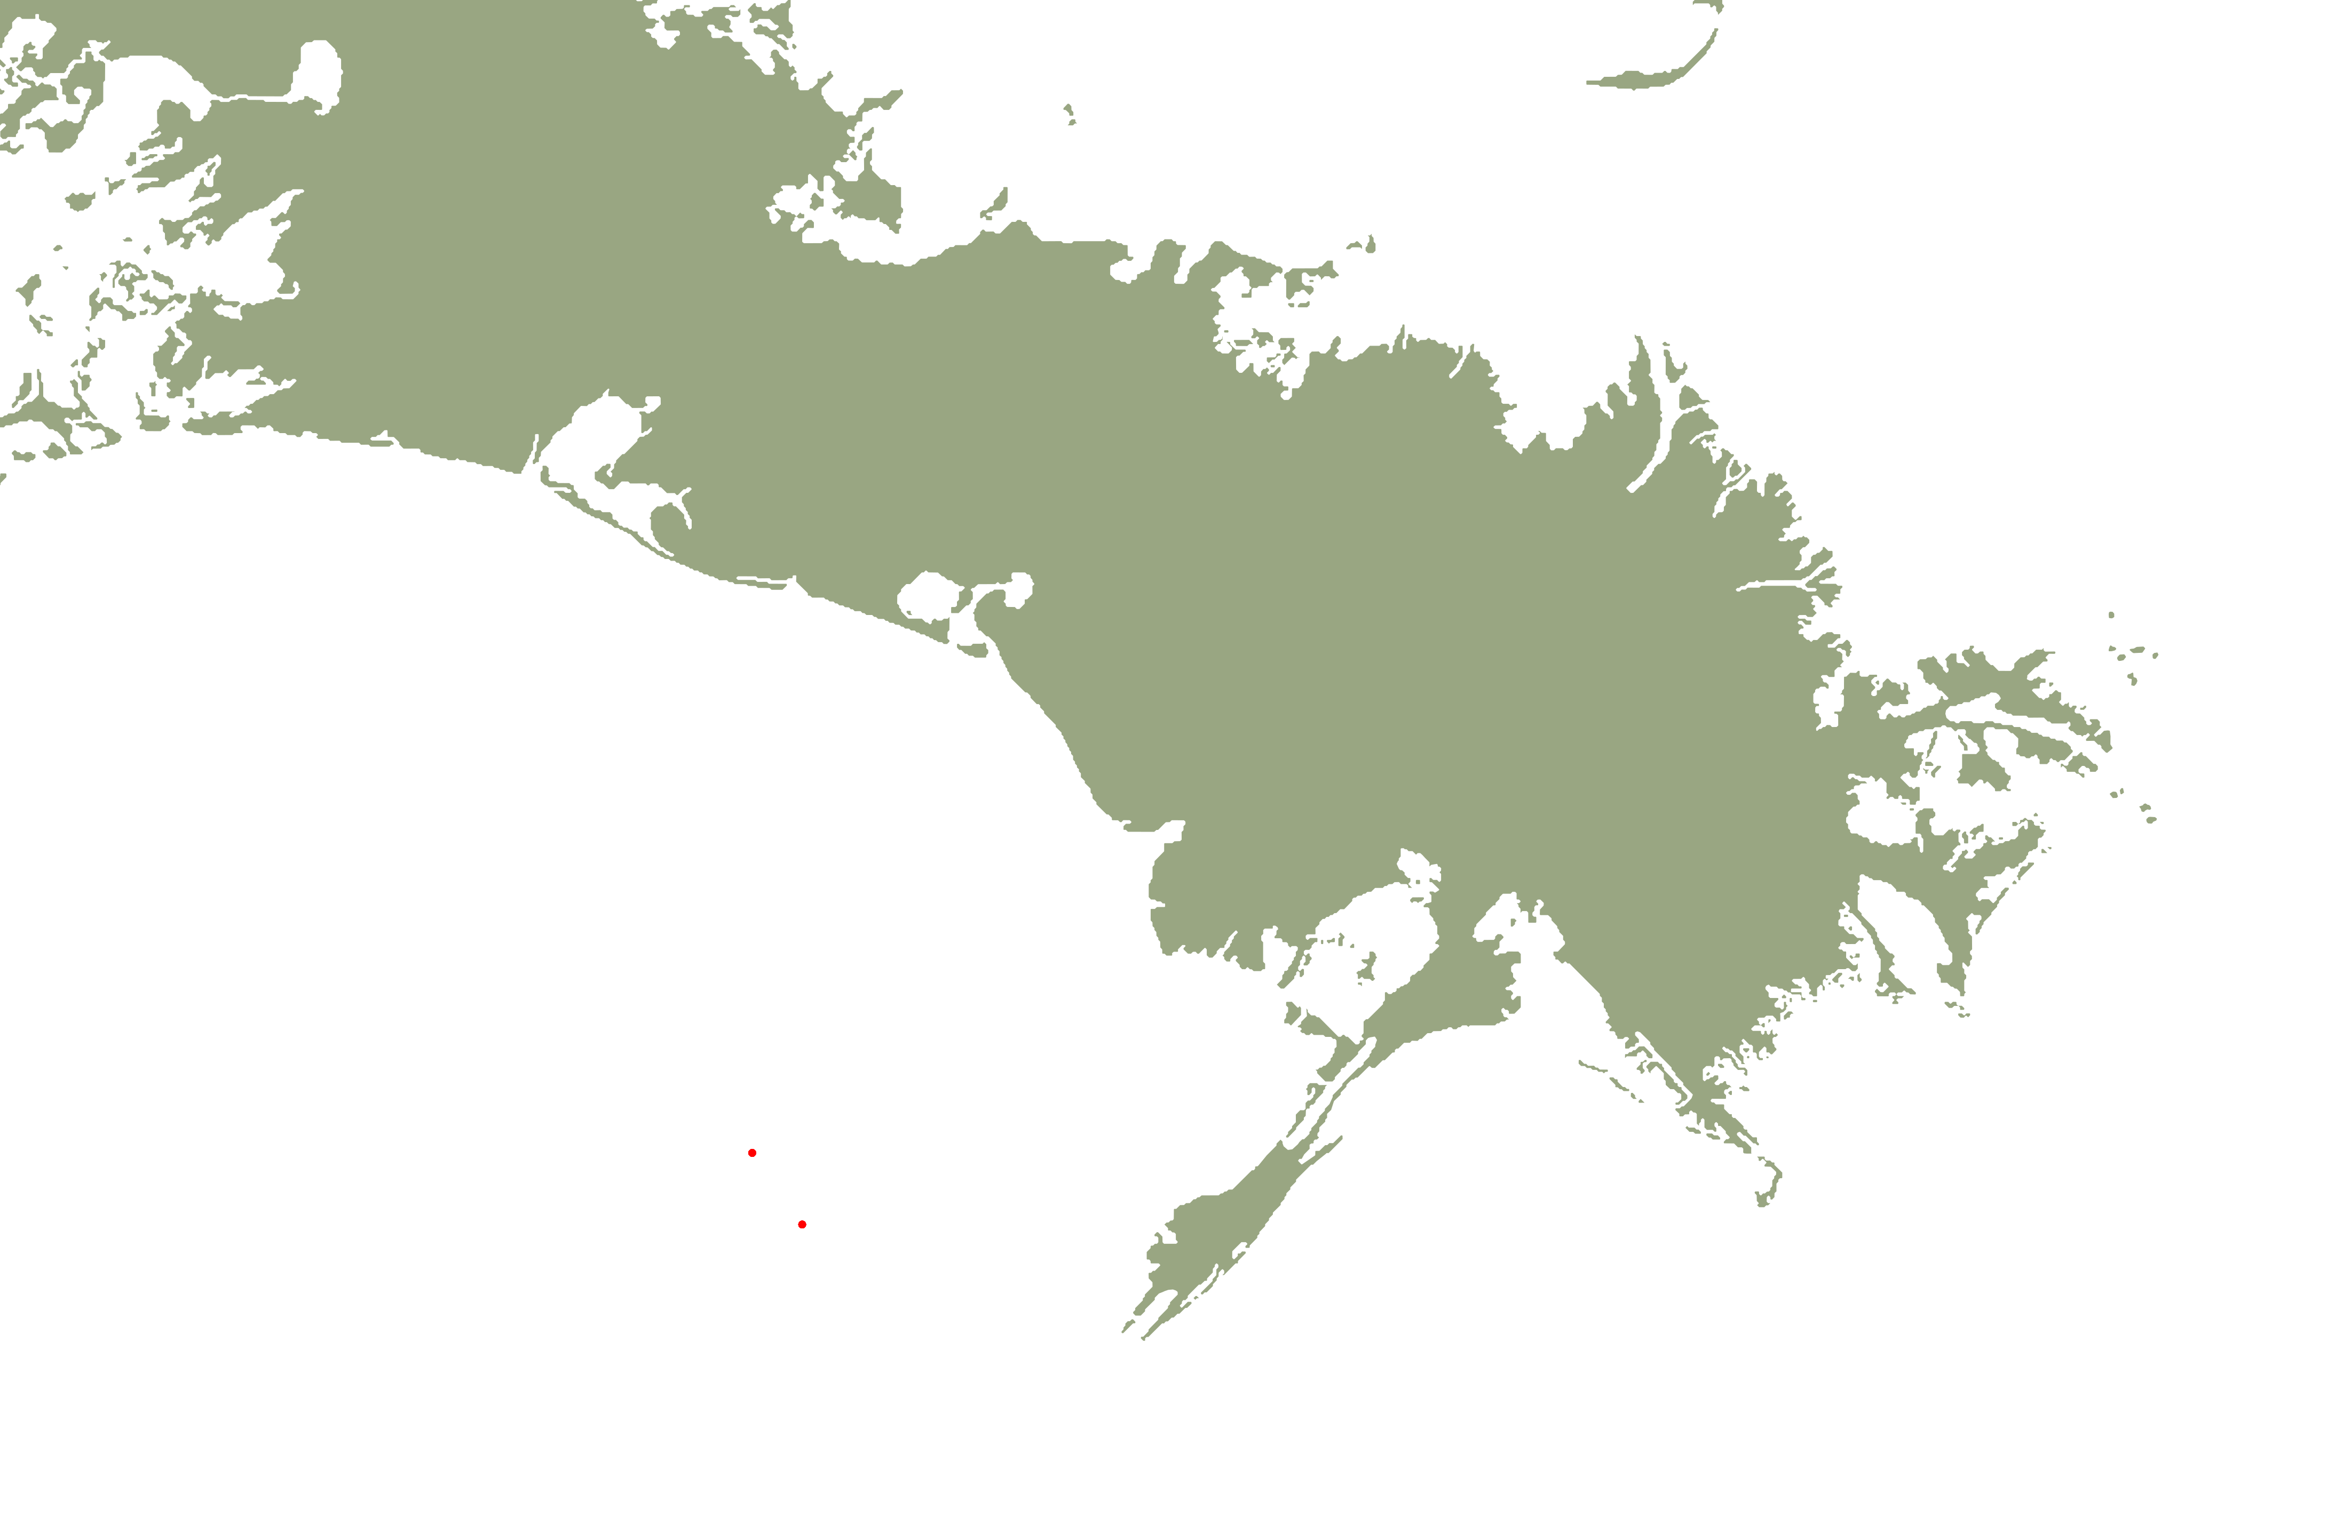
Fine-scale sampling
5
10 km
0

Slide 19
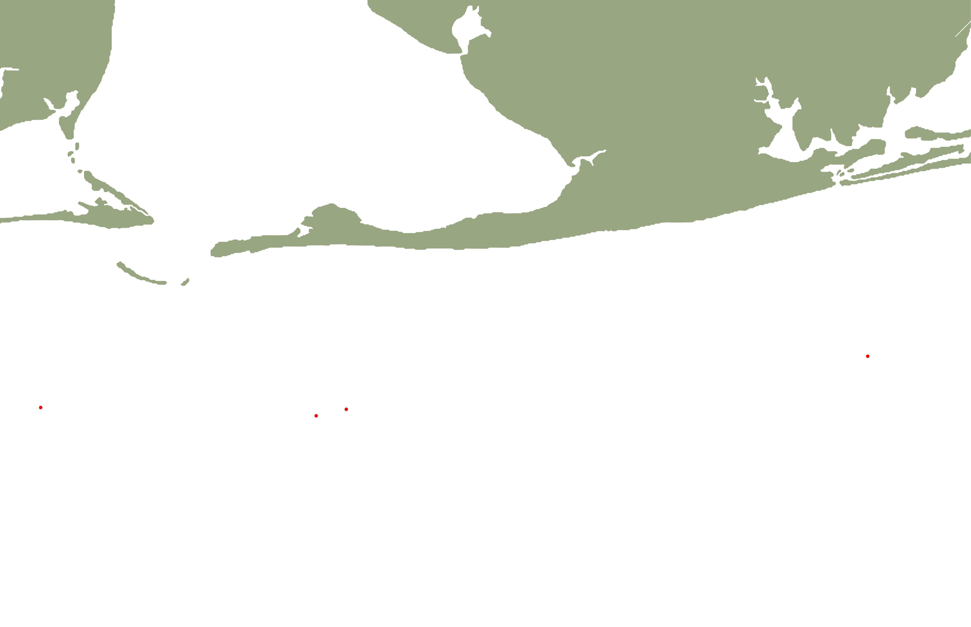
Fine-scale sampling
5
10
0
15 km

Slide 20
Fine-scale structure
NR1
NR2
AR1
AR2
AP2
NR3
NR4
AP1

Slide 21
Fine-scale structure
NR1
NR2
AR1
AR2
AP2
NR3
NR4
 | AP1 | NR3 | NR4 | NR1 | AR1 | AR2 | NR2
NR3 | 0.0008
NR4 | 0.0013 | -0.0006
NR1 | 0.0009 | 0.0004 | 0.0009
AR1 | 0.0021 | 0.0004 | 0.0015 | 0.0018
AR2 | 0.0005 | 0.0008 | -0.0002 | 0.0004 | 0.0022
NR2 | 0.0021 | 0.0005 | 0.0009 | 0.0025 | 0.0023 | 0.0015
AP2 | 0.0017 | 0.0006 | 0.0022 | 0.0009 | 0.0013 | 0.0009 | 0.0036
AP1

Slide 22
Fine-scale structure
NR1
NR2
AR1
AR2
AP2
NR3
NR4
 | AP1 | NR3 | NR4 | NR1 | AR1 | AR2 | NR2
NR3 | 0.0008
NR4 | 0.0013 | -0.0006
NR1 | 0.0009 | 0.0004 | 0.0009
AR1 | 0.0021 | 0.0004 | 0.0015 | 0.0018
AR2 | 0.0005 | 0.0008 | -0.0002 | 0.0004 | 0.0022
NR2 | 0.0021 | 0.0005 | 0.0009 | 0.0025 | 0.0023 | 0.0015
AP2 | 0.0017 | 0.0006 | 0.0022 | 0.0009 | 0.0013 | 0.0009 | 0.0036
AP1

Slide 23
Fine-scale structure
NR1
NR2
AR1
AR2
AP2
NR3
NR4
 | AP1 | NR3 | NR4 | NR1 | AR1 | AR2 | NR2
NR3 | 0.0008
NR4 | 0.0013 | -0.0006
NR1 | 0.0009 | 0.0004 | 0.0009
AR1 | 0.0021 | 0.0004 | 0.0015 | 0.0018
AR2 | 0.0005 | 0.0008 | -0.0002 | 0.0004 | 0.0022
NR2 | 0.0021 | 0.0005 | 0.0009 | 0.0025 | 0.0023 | 0.0015
AP2 | 0.0017 | 0.0006 | 0.0022 | 0.0009 | 0.0013 | 0.0009 | 0.0036
AP1

Slide 24
Drivers of fine-scale structure?
Selection
Pre- or post-settlement

Slide 25
Is selection driving the pattern?
NR1
NR2
AR1
AR2
AP2
NR3
NR4
AP1

Slide 26
Drivers of fine-scale structure?
Selection
Pre or post settlement
Differential reproductive success
“Sweepstakes recruitment”

Slide 27
Sweepstakes?
NR1
NR2
AR1
AR2
AP2
NR3
NR4
F = 11.5114, p < 0.001
AP1

Slide 28
Drivers of fine-scale structure?
Selection
Pre or post settlement
Differential reproductive success
“Sweepstakes recruitment”
Population Subdivision

Slide 29
Subdivision?
NR1
NR2
AR1
AR2
AP2
 | Estimate | 95% CI
AP1 | Infinity | 15,717- Infinity
NR3 | 5,021 | 2,389 - Infinity
NR4 | Infinity | Infinity-Infinity
NR1 | 10,540 | 5,025 - Infinity
AR1 | 1,281 | 1,022 - 1,714
AR2 | 59,110 | 8,819 - Infinity
NR2 | 1,663 | 1,254 - 2,466
AP2 | 3,835 | 2,238 - 13,308
NR3
NR4
AP1

Slide 30
Subdivision?
NR1
NR2
AR1
AR2
AP2
 | Estimate | 95% CI
AP1 | Infinity | 15,717- Infinity
NR3 | 5,021 | 2,389 - Infinity
NR4 | Infinity | Infinity-Infinity
NR1 | 10,540 | 5,025 - Infinity
AR1 | 1,281 | 1,022 - 1,714
AR2 | 59,110 | 8,819 - Infinity
NR2 | 1,663 | 1,254 - 2,466
AP2 | 3,835 | 2,238 - 13,308
NR3
NR4
AP1

Slide 31
Implications
Likely multiple brooding stocks
Could be inherent meta-population structure
spatial or temporal demes
Juvenescence of the fishery could be creating structure
Younger fish produce less and lower quality eggs, sperm, and larvae
Reduce pools of potential parents
Limit larval connectivity between localities
Only one year of data
Could just be an outlier
However, estimates of recruitment for the last decade peaked during 2012 (SEDAR 2013)

Slide 32
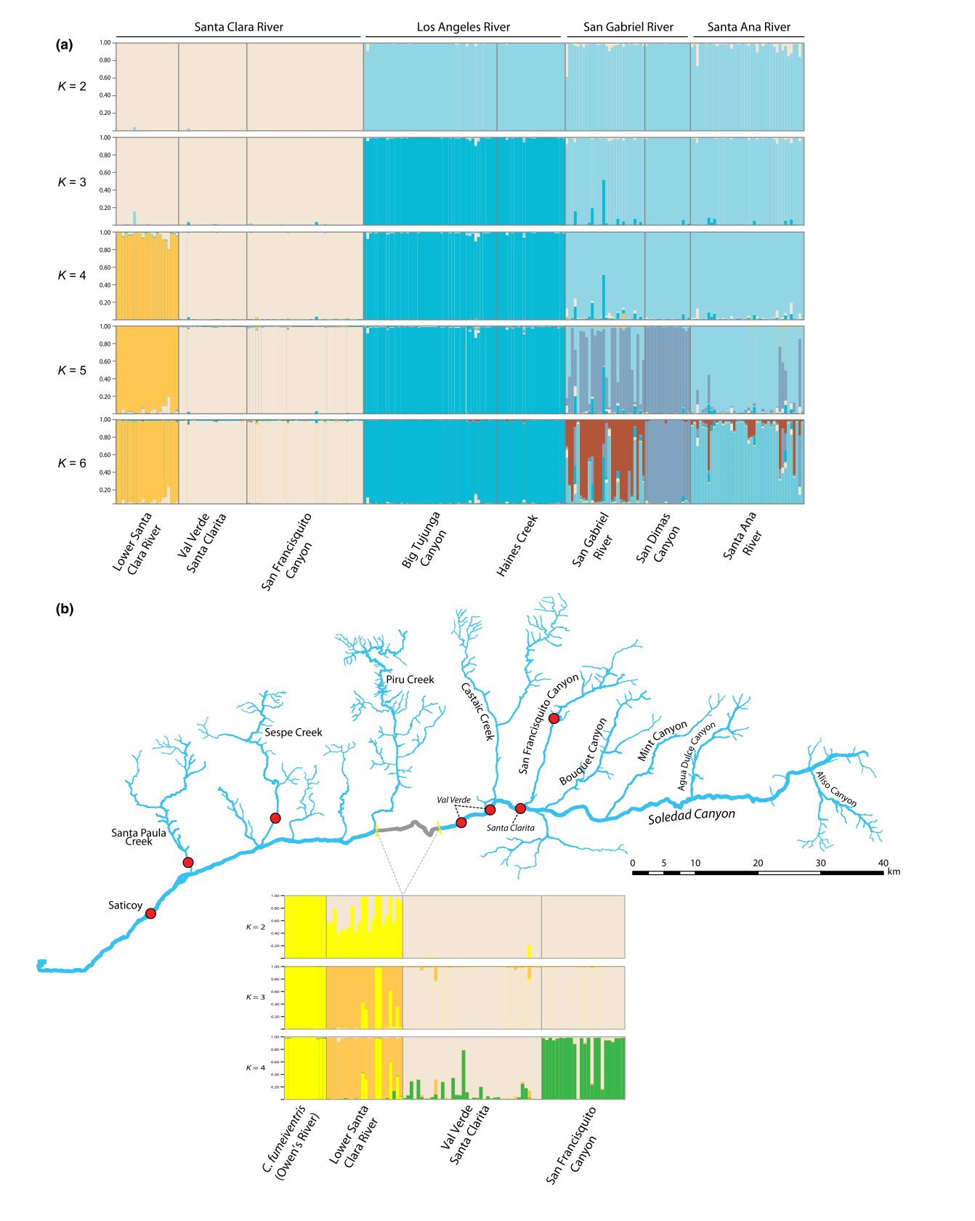
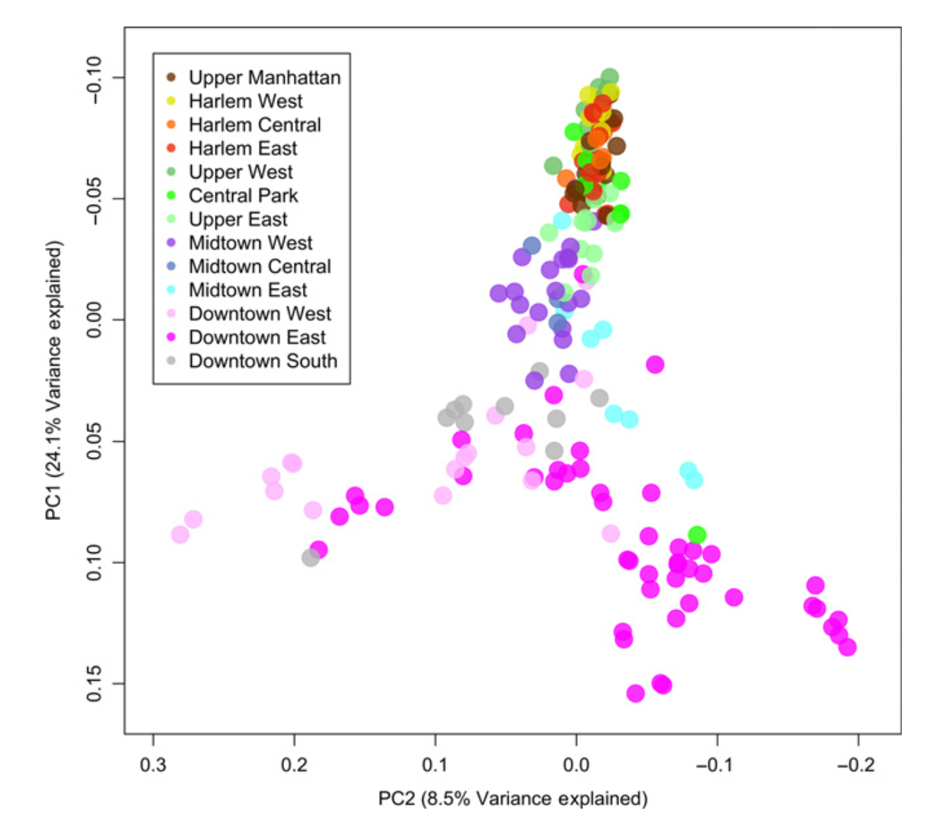
What is a population?
Technological improvements began shifting the focus of sampling from populations towards individuals
Bayesian clustering methods
Principal components analysis (PCA)
BIO 594

Slide 33
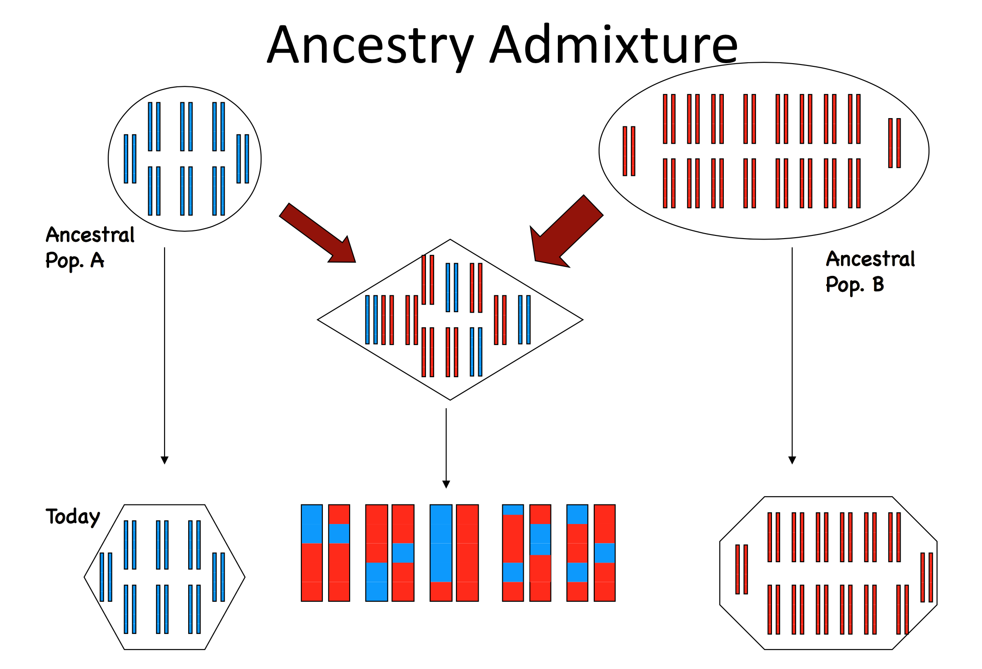
What is a population?
Structure model
Assumes that individual genomes are comprised of a combination of multiple ancestral alleles
Clusters can be identified by grouping individuals by maximizing HWE and minimizing LD
BIO 594

Slide 34
What is a population?
Structure model
Assumes that individual genomes are comprised of a combination of multiple ancestral alleles
Clusters can be identified by grouping individuals by maximizing HWE and minimizing LD
BIO 594

Slide 35
What is a population?
Structure model
Assumes that individual genomes are comprised of a combination of multiple ancestral alleles
Clusters can be identified by grouping individuals by maximizing HWE and minimizing LD
BIO 594

Slide 36
What is a population?
PCA
Imagine creating a giant matrix of genotypes arranged in rows of individuals and columns of loci
PCA reduces the dimensionality of all genetic variation by eigendecomposition
Axes of variation are defined by linear combinations of loci
 | Locus 1 | Locus 2 | Locus 3 | Locus 4
Individual 1 | 0 | 1 | 2 | 0
Individual 2 | 1 | 1 | 2 | 1
Individual 3 | 0 | 0 | 0 | 1
Individual 4 | 2 | 2 | 1 | 0
BIO 594

Slide 37
What is a population?
PCA
Imagine creating a giant matrix of genotypes arranged in rows of individuals and columns of loci
PCA reduces the dimensionality of all genetic variation by eigendecomposition
Axes of variation are defined by linear combinations of loci
BIO 594

Slide 38
What is a population?
Novembre et al. 2008
BIO 594

Slide 39
DAPC
DAPC
Uses principal component analysis to decompose the variation in allele frequencies into discrete axes
Groups can be input or inferred
Within group variation is minimized and between group variation maximized.
Can be used with either neutral or adaptive loci
Novembre et al. 2008
BIO 594

Slide 40
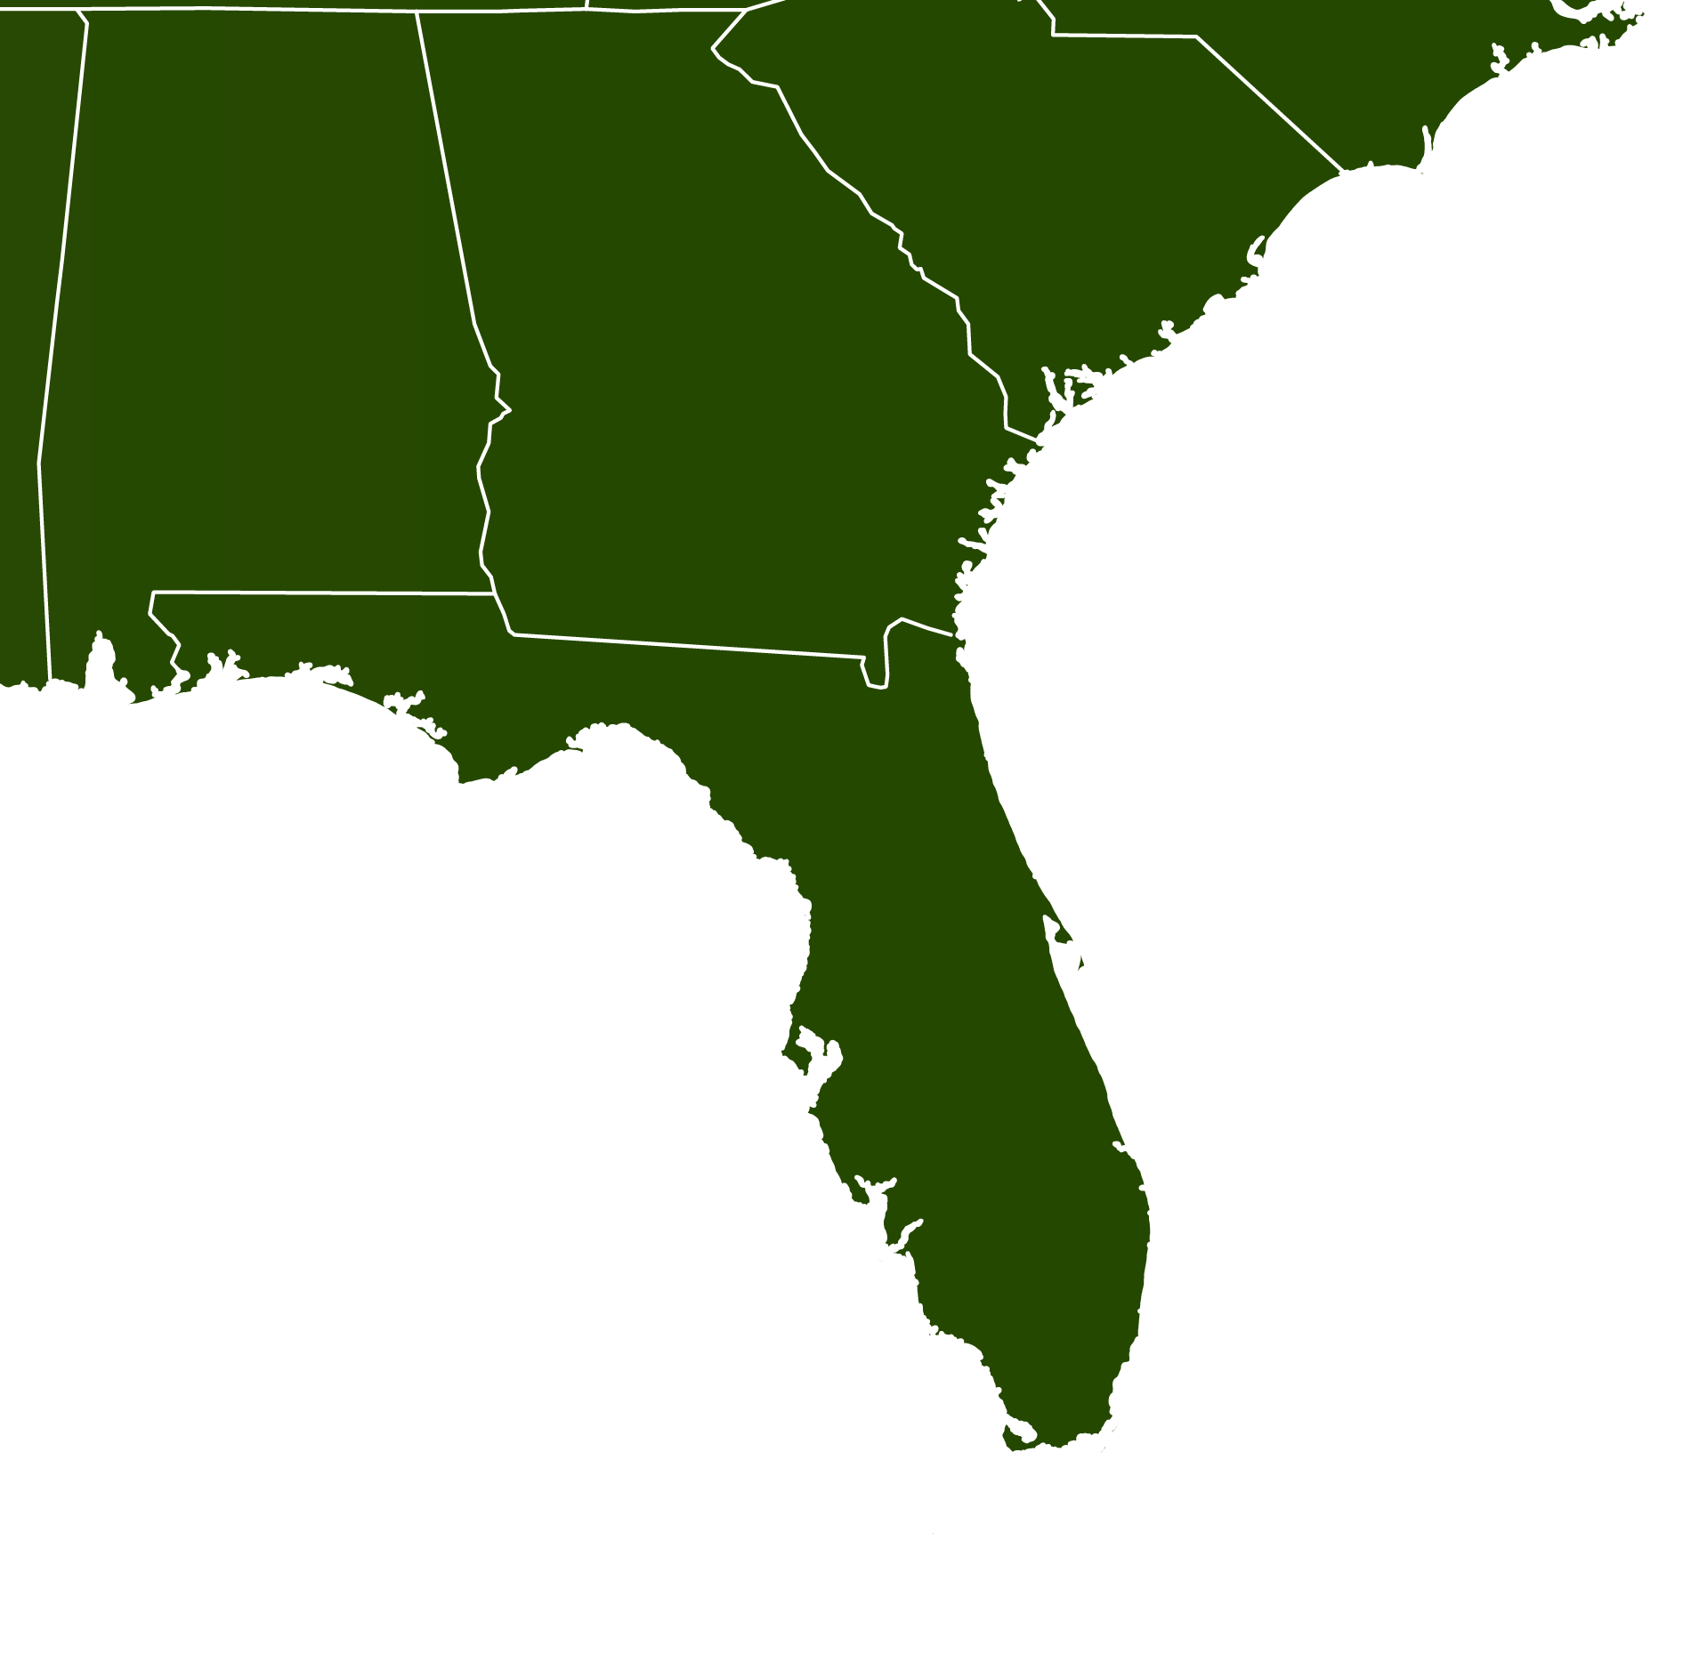
Bonnethead DAPC
Neutral
NC
22
PC
36
Outlier
TB
31
FB
31

Slide 41
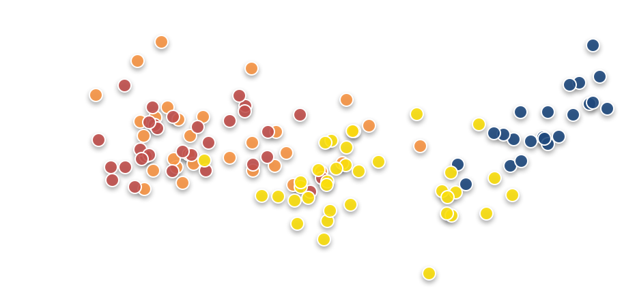
Drivers of outlier allele frequencies
NC
22
PC
36
TB
31
FB
31

Slide 42
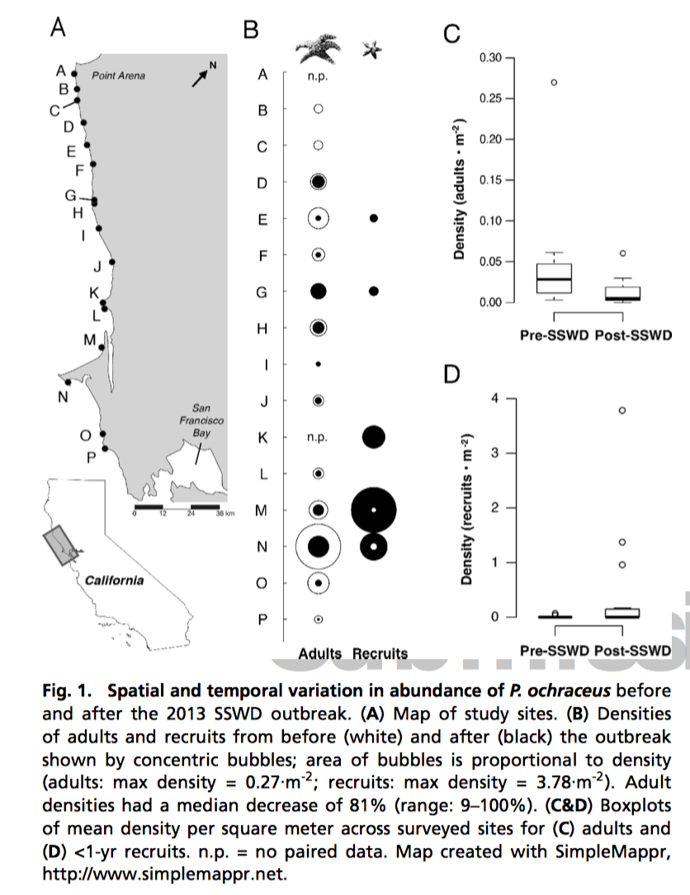
DAPC for detecting selection

Slide 43
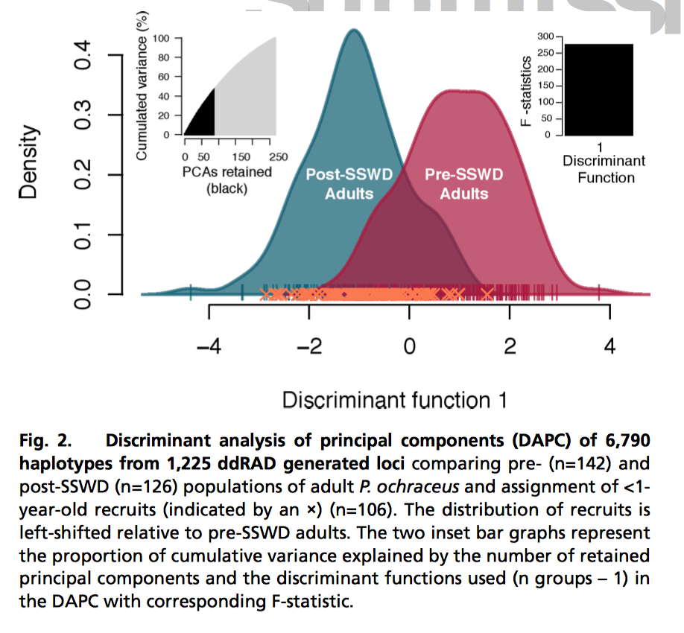
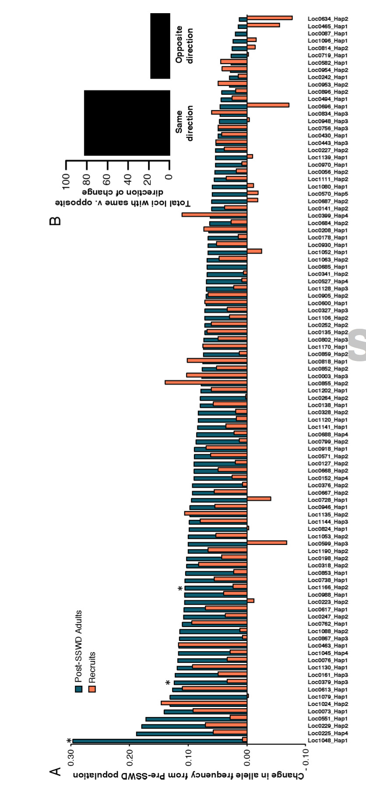
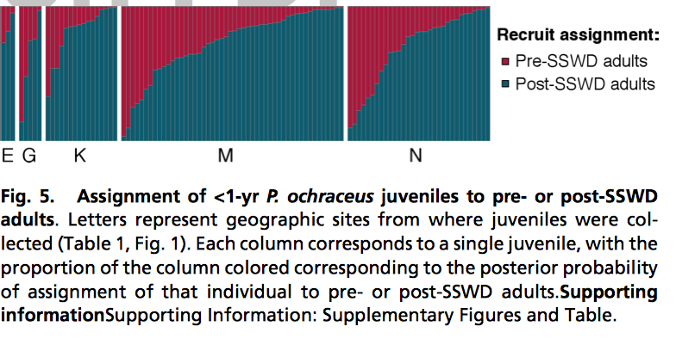
DAPC for detecting selection

Slide 44
DAPC for detecting selection

Slide 45
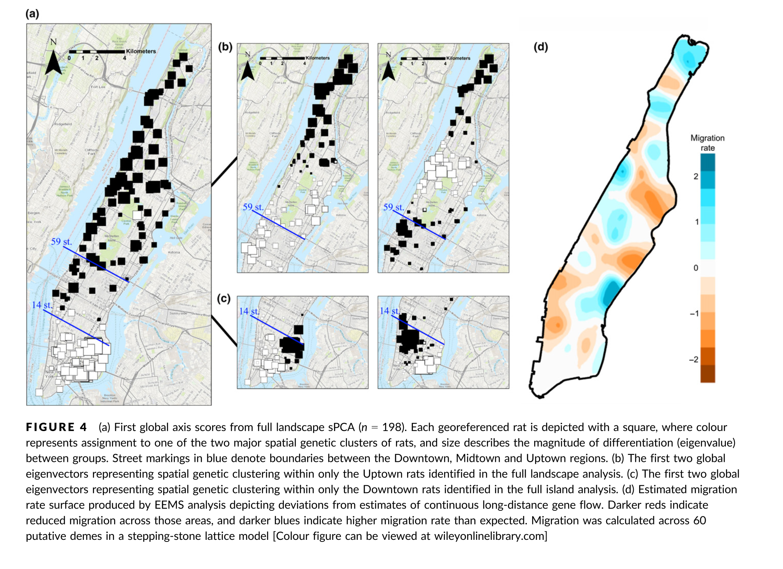
Population connectivity
BIO 594

Slide 46
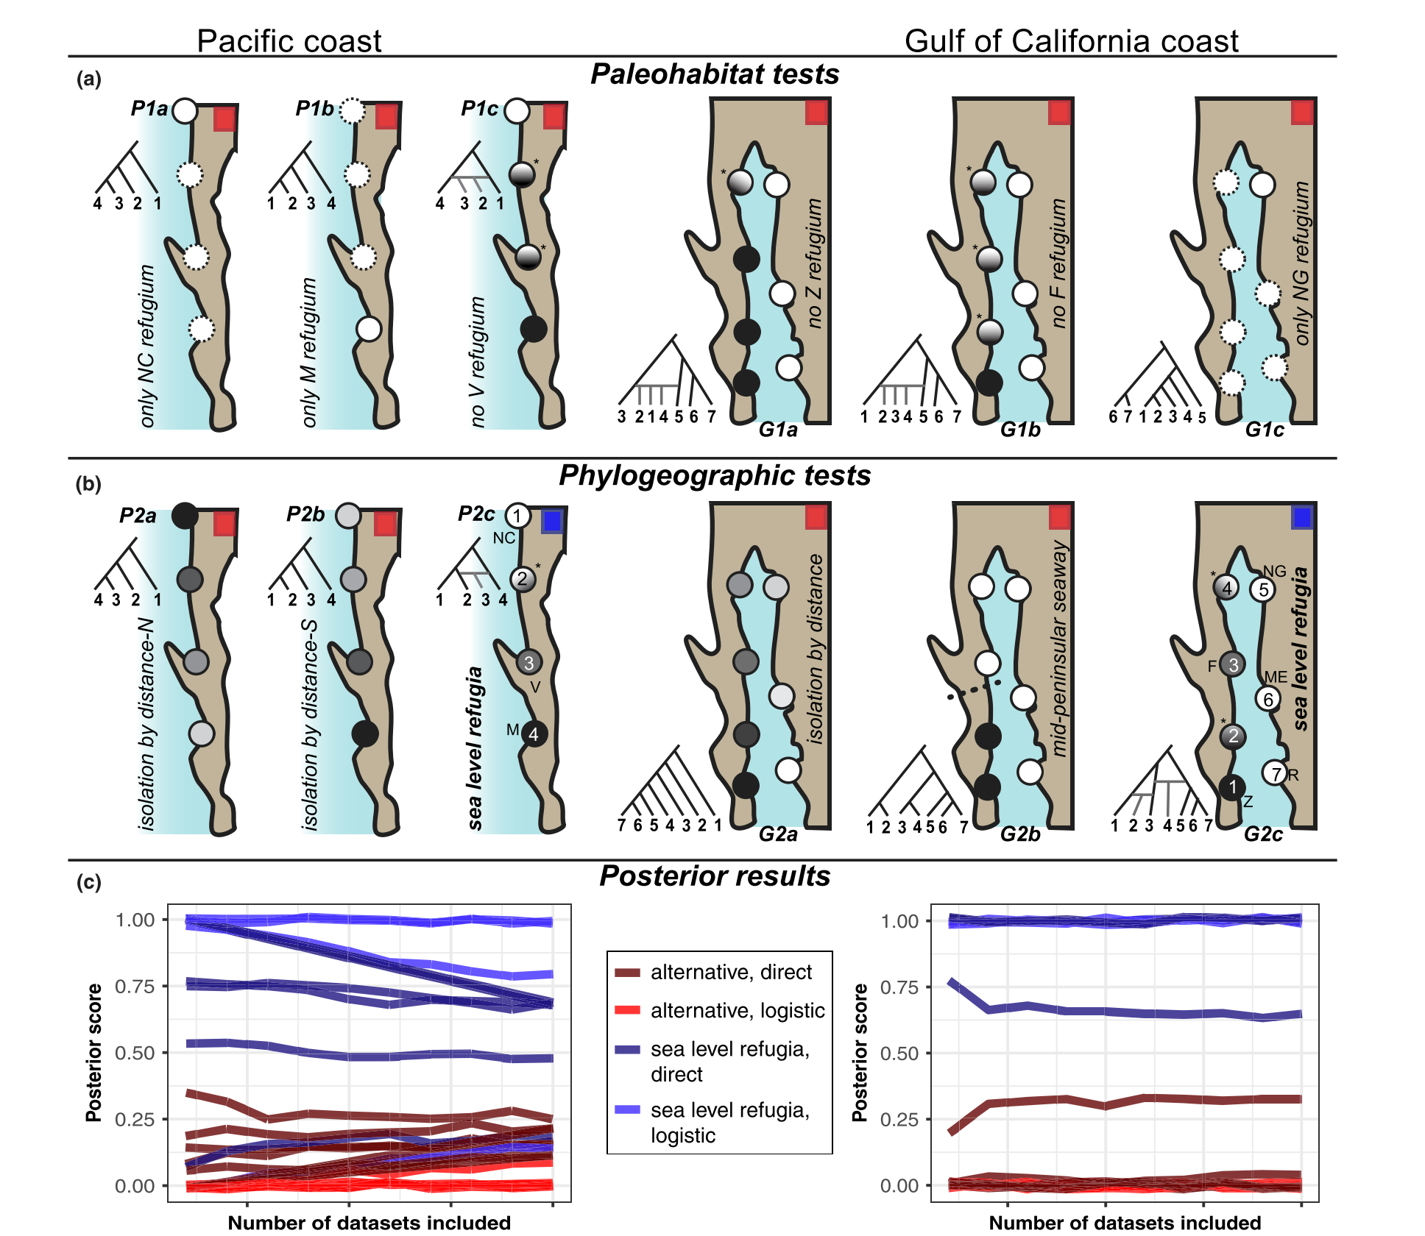
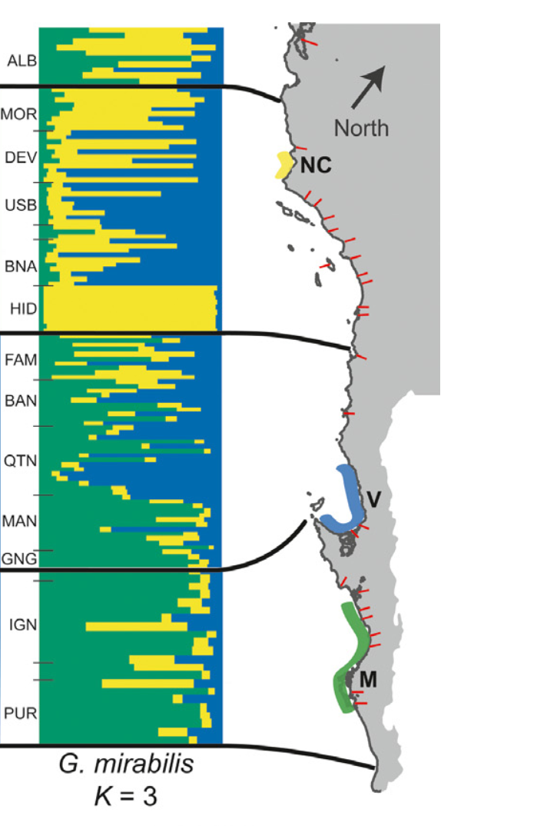
Inferring historical demography
BIO 594

Slide 47
Live Coding
Using the package adegenet
PCA
Missing data
Relatedness
DAPC
Inferring groupings
Inferring loci contribution
Inferring group membership
Repeat an analysis from an open data notebook!
From a graduate student, Catherine Silliman (https://github.com/ksil91)
F_{ST} heatmap
PCA with special coloring
EEMS

Slide 48
Exercise
Will be posted by 5pm today

